Slide 1

:
enera Structure
Problems based on PLA & PAL

Slide 2




PLA(Programmable Logic Array)
PLA is a PROM .It does not provide full decoding of the variables and will not generate all the minterms.
The PLA uses AND gates for decoder, each can be programmed to generate a product term of the input variables.
There are different set of fuse :
between n-inputs & complement.
The output of AND gates and OR gates input.
The output function as AND-OR-INVERT , AND-OR form.

Slide 3

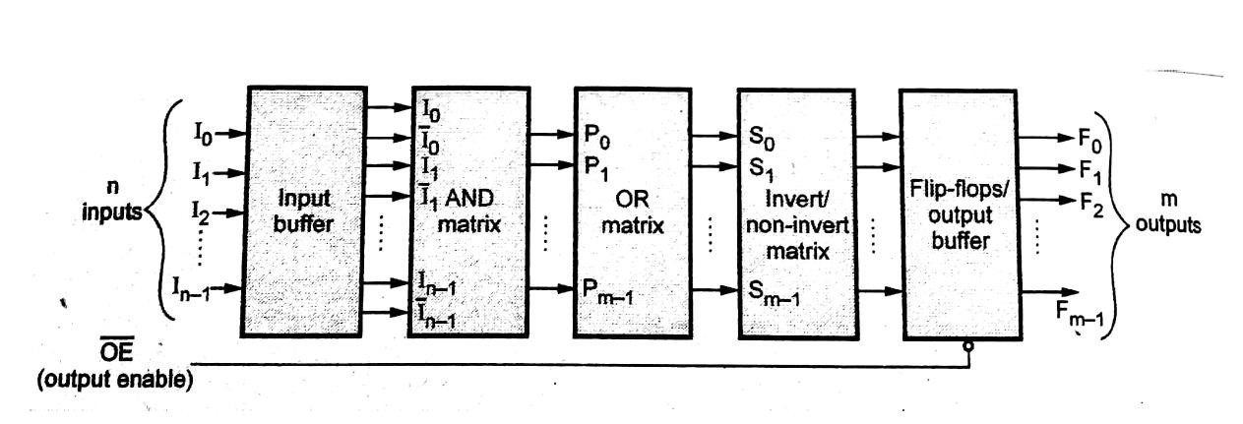
Block Diagram

Slide 4

PAL(Programmable Array Logic)
A programmable logic device with a fixed OR array and a programmable AND array.
AND gates are programmable.

Slide 5
PAL(Programmable Array Logic)
Consider the Boolean function
w(A,B,C,D)=∑(2,12,13)
x(A,B,C,D)=∑(7,8,9,10,11,12,13,14,15)
Y(A,B,C,D)=∑(0,2,3,4,5,6,7,8,10,11,15)
Z(A,B,C,D)=∑(1,2,8,12,13)
Solution:
w = ABC’ + A’B’CD’
x = A + BCD
y = A’B + CD + B’D’
z = ABC’ + A’B’CD’ + AC’D’ + A’B’C’D = w + AC’D’ + A’B’C’D

Slide 6
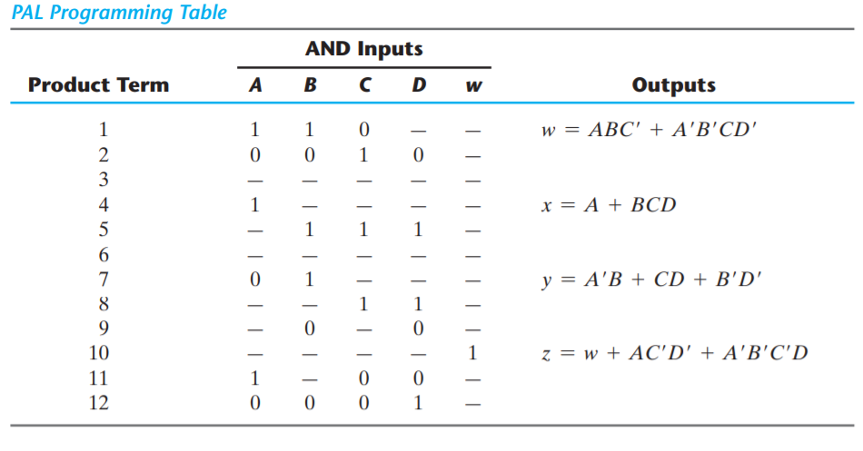

Slide 7
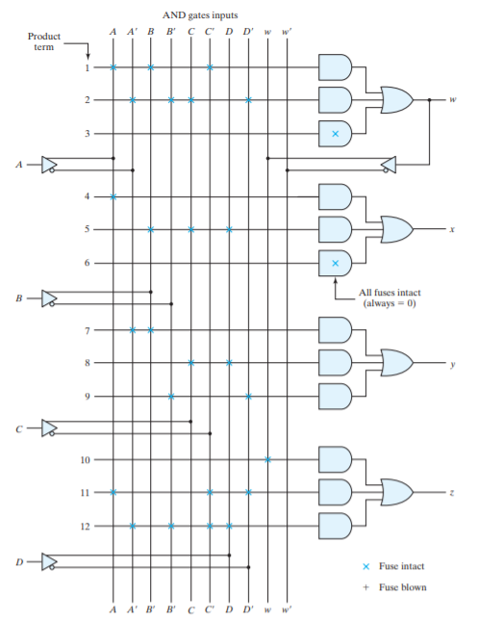

Slide 8

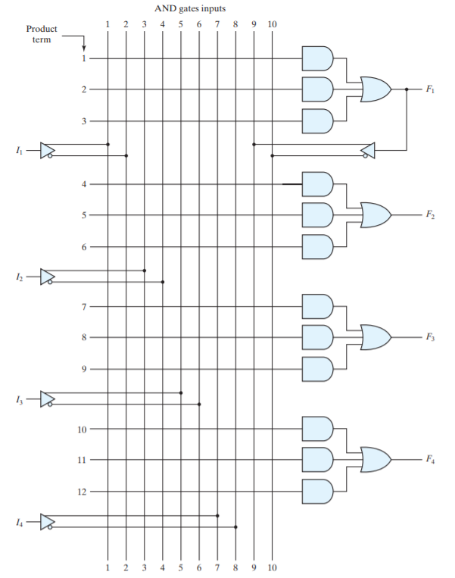
PAL with 4 inputs 4 outputs and a 3 wide AND OR structure.

Slide 9
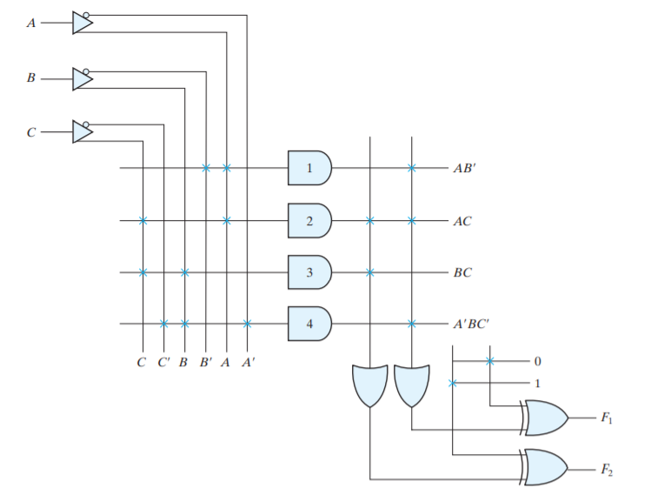
PLA Programmable Logic Array.
To implement the function
F1 = AB’ + AC + A’BC’ F2 = (AC + BC)’

Slide 10
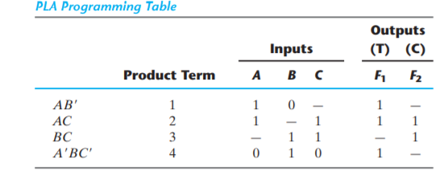
PLA Programmable Logic Array.
To implement the function
F1 = AB’ + AC + A’BC’ F2 = (AC + BC)’

Slide 11
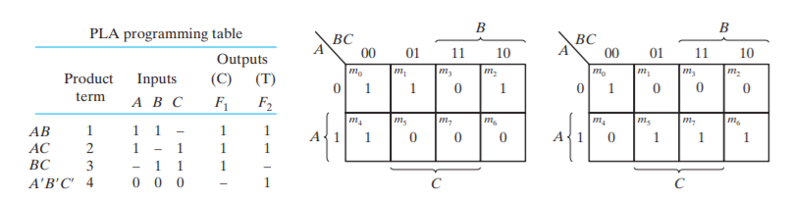
PLA Programmable Logic Array.
To implement the function
F1 = ∑(0,1,2,4) F2 =∑ (0,5,6,7)

Slide 12

Difference between PAL & PLA
PAL | PLA
AND and OR arrays are programmable. | OR array is fixed and AND array is programmable.
Cheaper and Simpler | Costliest and complex than PAL and PROMs

Slide 13

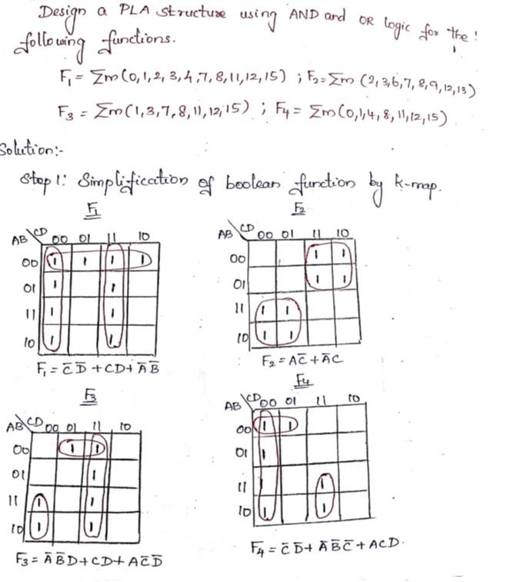
Problem

Slide 14

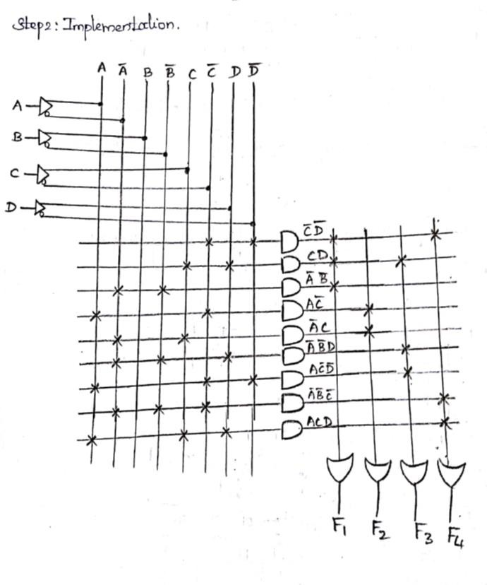

Slide 15

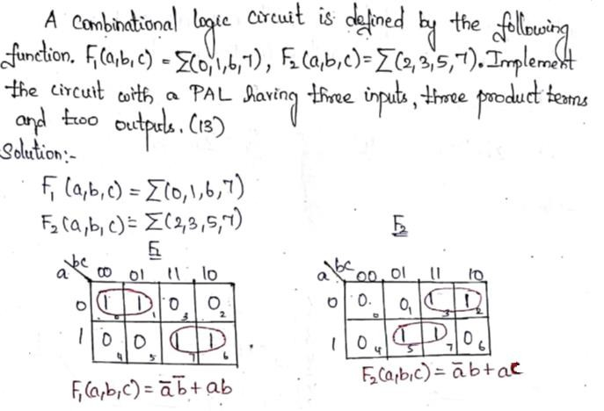

Slide 16

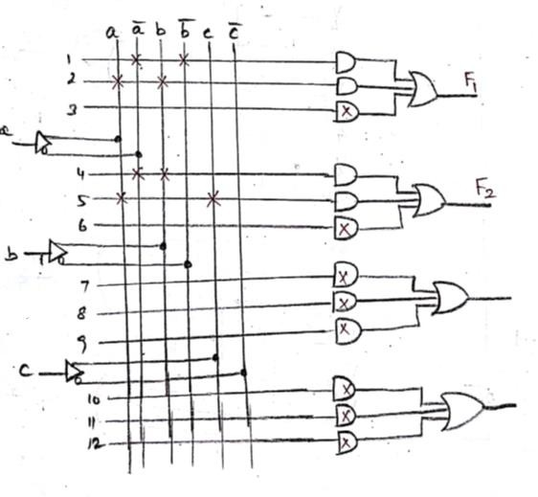
Implementation

